Slide 1
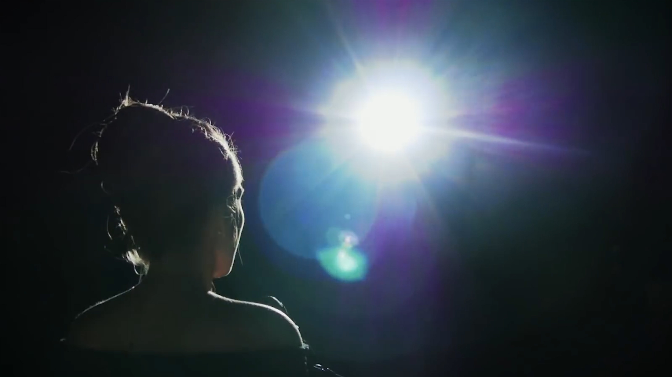
Emily White’s
story

Slide 2
①Emily White was born seventeen years ago with so many birth problems in her body. Some of her organs, bones and muscles were out of shape. No one expected her to survive. She did make it but with her strange body figure, everyone could recognize her, even from a distance.
②In Emily White's hometown, there was a yearly outdoor performance in the school auditorium(礼堂). It had been performed for so many years and actually had become one of the most important events of the Christmas season for many of the town's people.
③Many people tried out each year for it, but so many were turned away. It can only include the most excellent people in the field.
④Emily had a beautiful singing voice. Last year she went to Mrs. Owens- her music teacher to ask to join in the performance. Without letting her sing, Mrs. Owens took a look at Amy's body and said, "Child, you just don't fit. Everyone would stare at you and that would make you uncomfortable. It would make them uncomfortable, too.”
⑤Without singing a single note, Emily was sent back through the door of the choral room. Hurt and upset, she decided never to try out again. But Mrs. Owens then retired.
⑥This year, there came a new music teacher, Mr. Buttler. He heard about Emily and suggested that she have a try.
⑦Emily didn't want to be rejected again, so she hesitated a little about it. As Emily struggled, the door was pushed open and Mr. Buttler called, “Emily, you're next." Although kind of nervous, Emily did as Mr. Buttler told her to do. Mr. Buttler sat by the piano to keep Emily company. When Emily finished her testing performance, she thanked Mr. Buttler and knew the result would be posted on the door of the choral room the next day.
⑧Emily couldn't sleep that night. She was suffering from the feelings that she didn't fit and the great need to be accepted. By the next morning, her stomach was even in pain because of stress.

Slide 3

Read for Development of the plot
Para.1
Para.2-3
Para.4-5
Para.6-8
Para.9-10
The introduction of Emily —— a strange-looking girl
The introduction of a yearly performance in the town
Emily’s first attempt to sing (Mrs. Owens)
Emily’s second attempt to sing(Mr. Buttler)
Develop the plot logically and rationally!

Slide 4
02
Read for characters
(1) Emily White was born seventeen years ago with so many birth problems in her body. Some of her organs, bones and muscles were out of shape. No one expected her to survive. She did make it but with her strange body figure, everyone could recognize her, even from a distance.
(4) Emily had a beautiful singing voice. Last year she went to Mrs. Owens – her music teacher to ask to join in the performance. Without letting her sing, Mrs. Owens took a look at Amy’s body and said, “Child, you just don’t fit. Everyone would stare at you and that would make you uncomfortable. It would make them uncomfortable, too.”
(5) Without singing a single not, Emily was sent back through the door of the choral room. Hurt and upset, she decided never to try out again. But Mrs. Owens then retired.
(6) This year, there came a new music teacher, Mr. Buttler. He heard about Emily and suggested that she have a try.
(7) Emily didn’t want to be rejected again, so she hesitated a little about it. As Emily struggled, the door was pushed open and Mr. Buttler called, “Emily, you’re next.” Although kind of nervous, Emily did as Mr. Buttler told her to do. Mr. Buttler sat by the piano to keep Emily company. When Emily finished her testing performance, she thanked Mr. Buttler and knew the result would be posted on the door of the choral room the next day.
(8) Emily couldn’t sleep that night. She was suffering from the feelings that she didn’t fit and the great need to be accepted. By the next morning, her stomach was even in pain because of stress.
Emily's strange figure
confident
depressed
self-doubt
stressed/nervous

Slide 5
the given hints
(7) ......the result would be posted on the door of the choral room the next day.
(8) Emily couldn’t sleep that night. She was suffering from the feelings that she didn’t fit and the great need to be accepted. By the next morning, her stomach was even in pain because of stress.
Paragraph 1:
(9) The next day, Emily nervously glanced at the list on the door of the choral room. ____________________________________________
success ？
！
Paragraph 2:
(10) Finally, the day of performance came. __________________

Slide 6
A sharp contrast
What’s the function of the role of “Mrs. Owens” ?
set a major conflict for Emily’s story
 | Mrs. Owens | Mr. Buttler
words/ actions | “Child, you just don't fit. Everyone would stare at you and that would make you uncomfortable. It would make them uncomfortable, too” Sent her back without even letting her singing a single note. | Suggested Emily’s having a try “Emily, you're next” Kept her company
attitudes | negative and disapproving | concerned and caring encouraging and supportive
influences on Emily | Hurt and upset, she decided never to try out again. | Though hesitant and struggling, she took the challenge .
lead to Emily’s self-denial / lack of confidence in herself and in people around her.
Main characters:
Emily and Mr. Buttler
Will Mr. Buttler offer help? How?

Slide 7
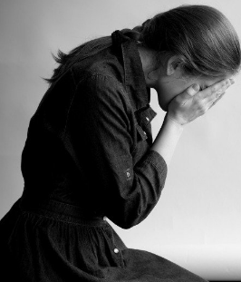
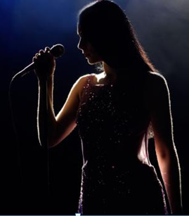
Character growth
How could Emily walk out of the shadow and regain confidence in the performance?
a beautiful singing voice(her talent+her confidence in it--internal factor)
determination/toughness/self-acceptance/self-adjustment (mental strength)
encouragement and support from Mr. Buttler (external factor)

Slide 8
03
Read for theme
clue 1:
a strange body figure
comparision
beautiful songs
a brave heart
1. Don't judge a person by his appearance!
clue 2:
comparision
Mrs. Owens: not supportive
Mr. Buttler: supportive
2. The power of encouragement is out of imagination/ makes a significant difference.
clue 3:
3. Confidence makes everything!

Slide 9
Continuation analysis
Main idea: Emily found her name on the list
Paragraph1:
The next day, Emily nervously glanced at the list on the door of the choral room.
stages | feelings | mental or physical responses
before finding her name
nervous, anxious
Eyes brightened/lit up/sparkled with joy
Blood flushed in the vein热血沸腾
…
on spotting her name
surprised
after confirming her name
thrilled
Throat tightened
Chest burned
Heart thudded/pounded/beat wildly
Palms sweating
1. 如果续写情节比较清晰明了，可适当放慢叙事节奏，或添加合理冲突，以更好地凸显主题。
2. 以人物情感情绪变化为线索，适当添加具体的人物心理描写及对应的physical responses, 使人物形象更立体饱满。

Slide 10
Main idea: Emily gave a wonderful performance
with the encouragement of Mr.Buttler
Paragraph2:
Finally, the day of performance came.
stages | feelings | Mental or physical responses
before the performance
during the performance
after the performance
nervous
Face flushing red/lit up
Mind blank
Eyes dizzy
Body clumsy
Feel butterflies in her stomach 忐忑不安
…
embarrassed, uneasy----calm, confident
delighted, grateful
1. Which part of narration could be slowed down?
2. What conflicts could be set? How to solve?

Slide 11
our problems:
1.对话太长且无营养；
2.情节单一，起伏不够。如第一段可凸显知道名单结果前后Emily的情绪对比；Mr Buttler 及时出现的意义(奥力给）；第二段深化主题，凸显老师的鼓励陪伴和Emily的彷徨到重拾自信最后绽放光芒；
3.结尾的主题突然，与原文的人设或者与前文的写作衔接度不够
4.适当控制字数，不宜太长。若描写没有主次，重点就凸显不出来.

Slide 12
No prejudice, no laughter. The respect and approval eventually found her due to her continuous efforts.

Slide 13
Name by name, she moved her eyes down inch by inch with palms sweating, praying for a miracle, but still no “Emily White” in signt. As she was nearly plunged into an abyss of despair, she gasped in wonderment at her good luck--her name was on the list . Immediately a wild joy took hold of Emily and she couldn't help weeping.
Line by line, she searched her name with eyes glued to the screen and heart banged against her ribs

Slide 14
Behind her came the voice of Mr Buttler,”Your voice is amazingly fanscinating. You deserve the chance.” This words eventually triggered a broad smile on Emily's face, casting a ray of sunshine right into her heart. “Thank you!” she giggled, eyes twinkling. The moment she arrived home, she threw herself into painstaking practice.

Slide 15
An appealing ending?

Slide 16


Part III Appreciation
参考范文和学生作品评析

Slide 17
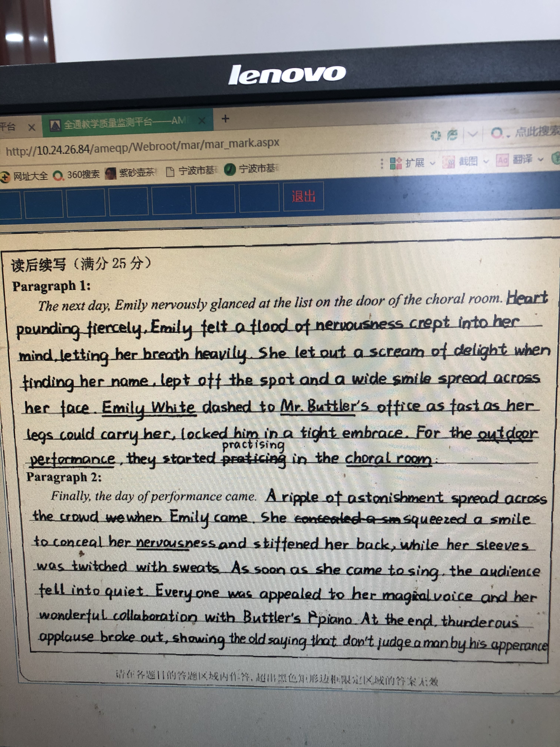
优秀范文赏析一
从本文这么多表达细致入微的句子可以得知作者是一位语言功底深厚的学生，描述性语言丰富；美中不足的是文章的内容不够丰富，故事情节发展不多，故上五档比较勉强。

Slide 18
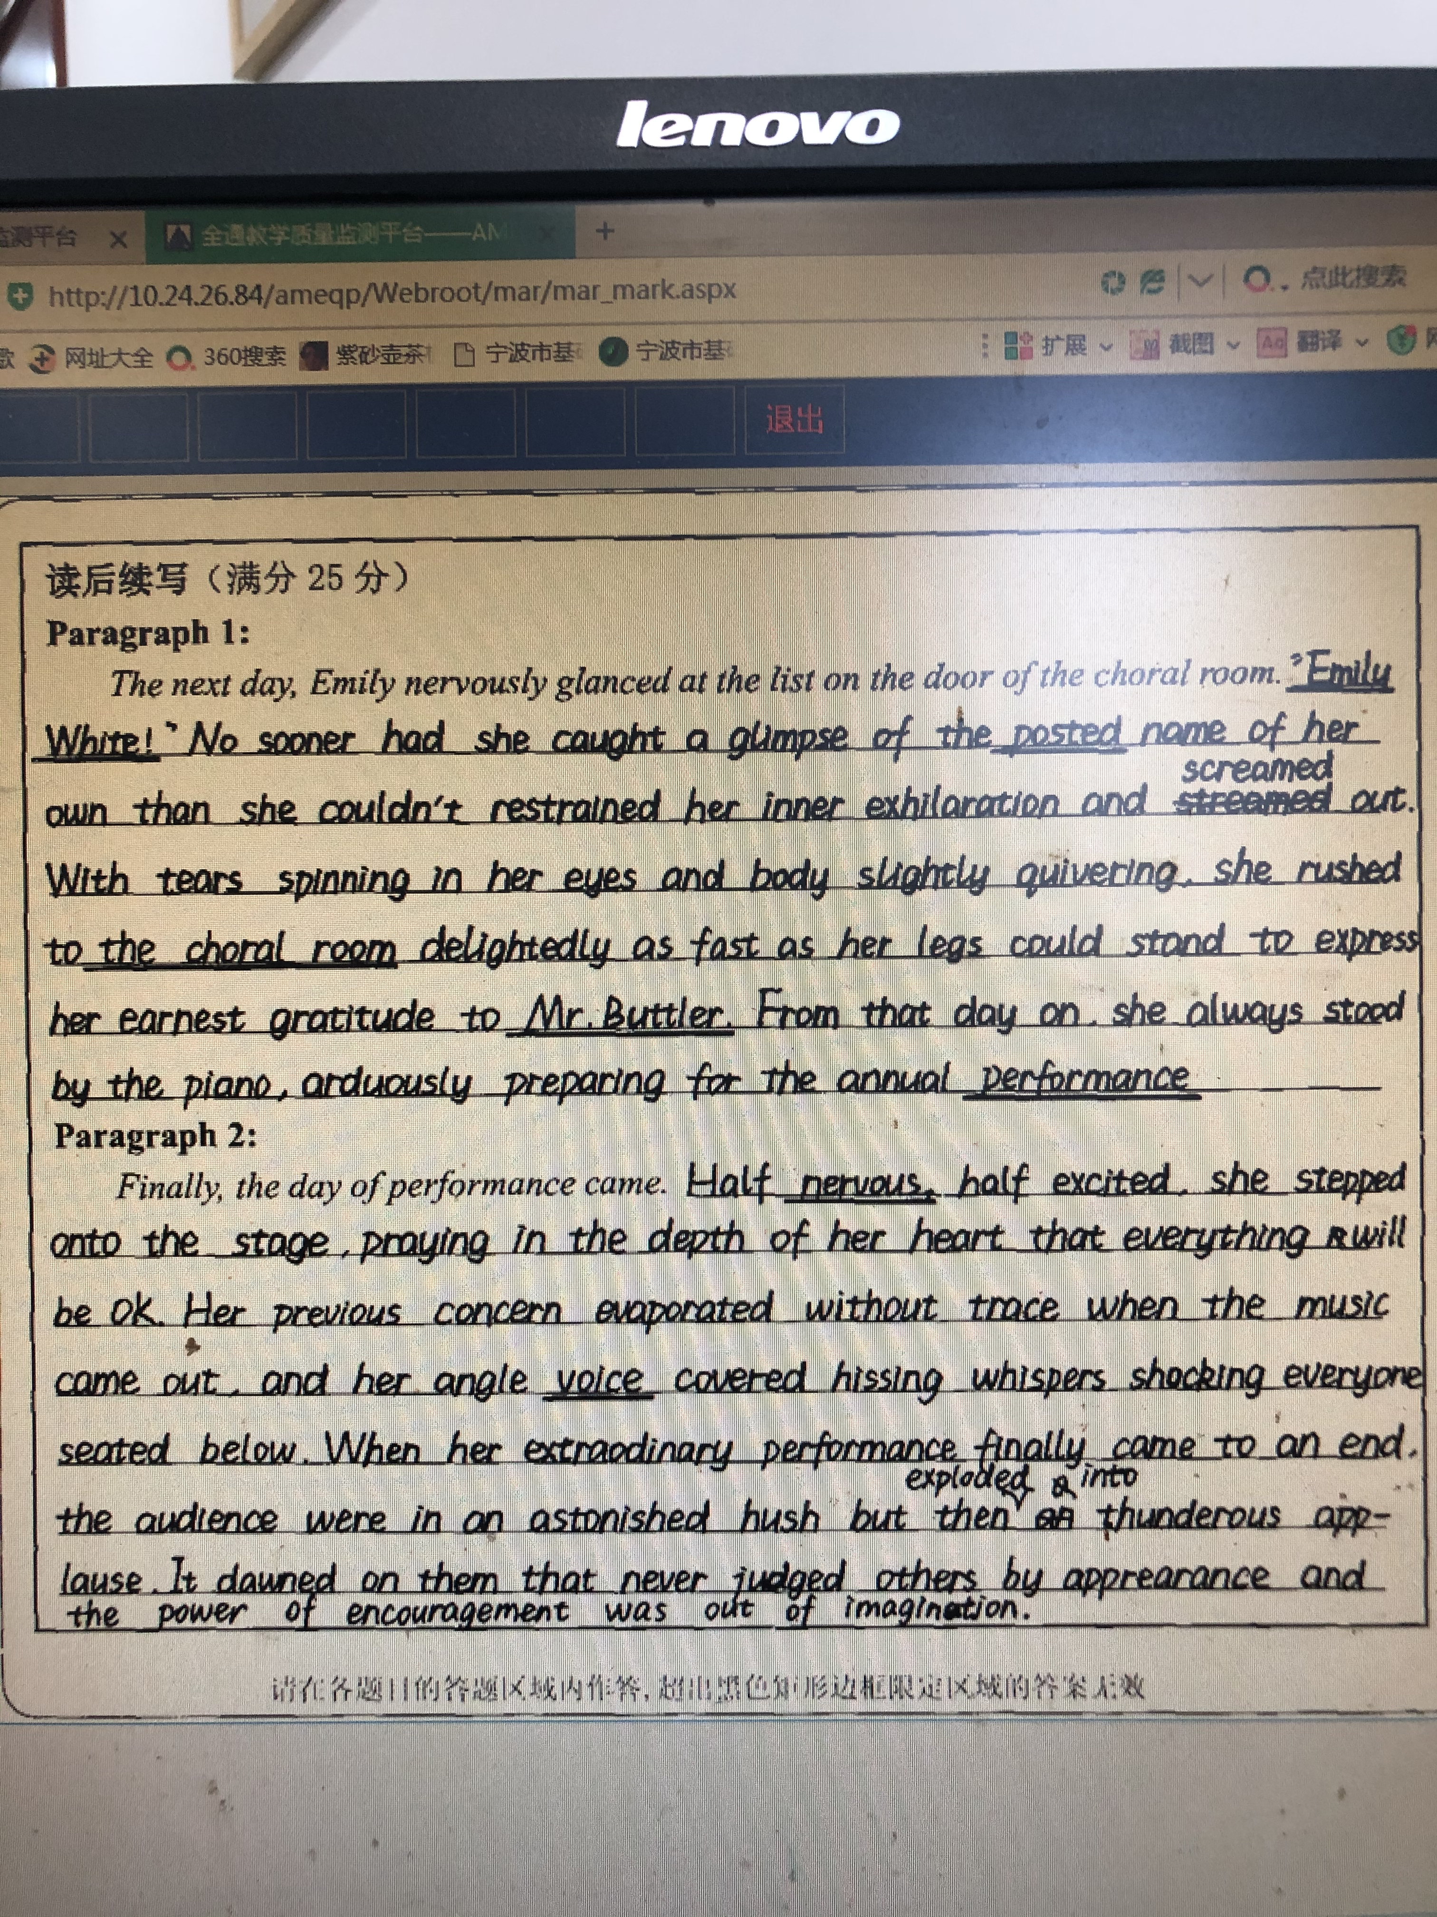
优秀范文赏析二
本文从情节内容，情感输出，前后文衔接，细节描写，语言表达，书写卷面等方面都很优秀，极个别词汇有误(angle--angelical，等)，主题升华有点牵强，若能突出老师的作用会更好。
建议五档。

Slide 19
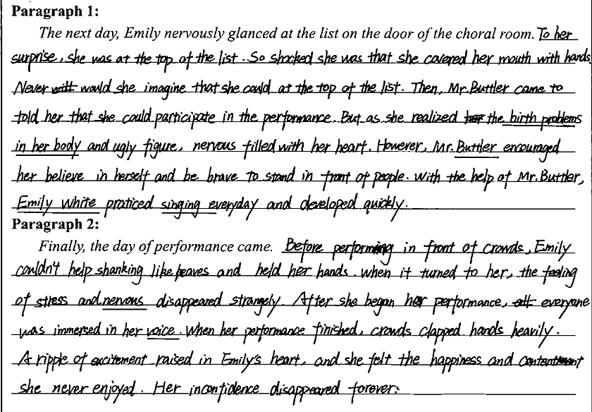
学生考场作文点评
So shocked was she…
tell
合理冲突：自我怀疑
冲突解决：Mr. Buttler再次鼓励并帮助练习
nervousness filled her heart
to believe
情绪走向：上台表演前的“紧张” ，开始表演后的“惊艳”，及表演后的“欣喜”
it was her turn,
nervousness
rose
She regained her confidence.

Slide 20
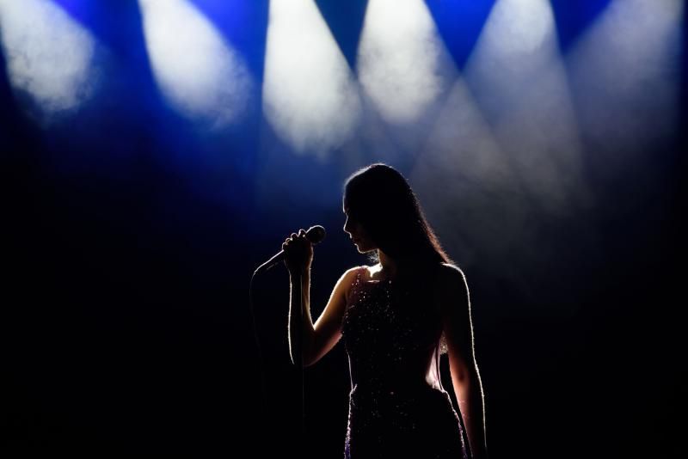
Thank you

Slide 21
老师下水作文
Paragraph 1
The next day, Emily nervously glanced at the list on the door of the choral room. Worried that she might be rejected again, she felt her throat tighten standing among a crowd of students, anxious to know the result. Hardly had her eyes settled upon the very top of the list when the name “Emily White” abruptly popped into her sight. It was so incredible that she rubbed her eyes over and over again to ensure it was the right “Emily White” she was looking for. Realizing there was not a second “Emily White” in the school, she jumped up and let out a cry of exhilaration. What made her even more surprised was that Mr. Buttler told her she was the lead singer in the performance.
Paragraph 2
Finally, the day of performance came. When all the performers did the last rehearsal in the choral room, Emily seemed to be quite confident about the upcoming performance. However, as she stepped onto the stage, spotlight fixed upon her, a sense of embarrassment and uneasiness flashed across her again. Gradually she found herself clumsy and even dizzy standing in the center of the stage. Just at that moment, she got a glimpse of Mr. Buttler in the corner of the hall, who shot Emily a determined look and then clapped loudly to give her a cheer. Taking a deep breath, Emily, with her eyes closed, started to sing. Immediately, the whole auditorium erupted into applauses. Their performance turned out to be a great success.

Slide 22
参考范文
Paragraph 1
The next day, Emily nervously glanced at the list on the door of the choral room. She was not rejected this time. Her name was posted at the top of the list. She, Emily White, was chosen to be the leading singer! She would sing alone in the performance. Emily couldn’t believe her eyes. There must be some mistake. But Mr. Buttler said to her with determined eyes, “Emily, I choose you because you should perform the part—your voice is unusual. Believe in yourself.” Greatly encouraged, Emily practiced really hard.
Paragraph 2
Finally, the day of performance came. Standing in front of the line, Emily felt her throat tight and her palms sweating. When the curtain opened up, the eyes of the whole audience fell upon Emily. “Emily White!” Someone whispered. Then, along with the first note of music, Emily began to singer her heart out. Her voice was like a nightingale ringing in the auditorium. Applause! Emily felt so happy and comfortable. She was shining on the stage. Emily White, with so many birth problems in her body, was an angel!

